Slide 1
2024 Allen D. Nease Marching Band
General Booster Meeting
Wednesday, April 17, 2024

Slide 2
Agenda
Welcome
General Updates
2024 – 2025 Budget
By Law Updates
Board Elections
Questions and Answers

Slide 3
General Updates

Slide 4
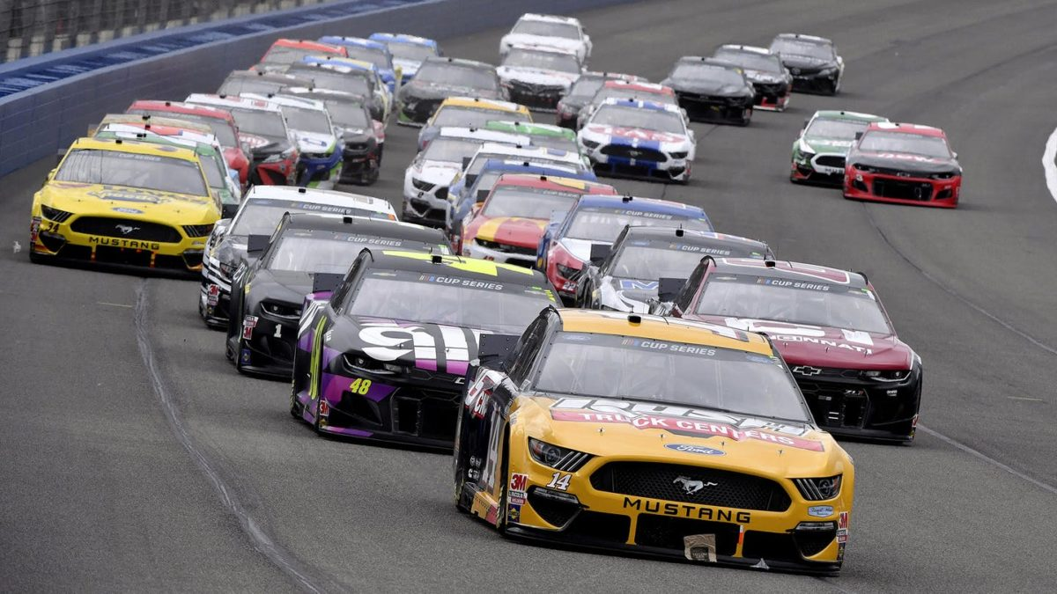
Daytona 500 Tickets
If you purchased tickets for the Daytona 500 Race though our Friends and Family, complete the form at this link:
https://docs.google.com/forms/d/e/1FAIpQLSdX9QP3pIq8GIJW_sHDhp0C71_PAUmCyphWXbW-N-NkldyXOA/viewform
Per Daytona Policy, refunds are not given; tickets are rolled over to the next year
Response is due by April 19th

Slide 5
End of Year Banquet
Friday May 17th at 6:00 pm
Ramada by Wyndham Jacksonville Hotel & Conference Center
3130 Hartley Road, Jacksonville, Fl 32257
Tickets are $35 each; you must pay for your student
Band dues must be paid in full
Last day to purchase tickets is May 1st
Business/dressy attire
This Photo by Unknown Author is licensed under CC BY-NC

Slide 6
Spring Spectacle
Dress rehearsal – Tuesday April 30th 4:30 – 6:30 pm
Performance – Wednesday May 1st 5:45 – 8:15 pm
Come out and enjoy!

Slide 7
Rising Panthers Night
Two nights for 8th graders and their parents to learn about the band
Rescheduled to Monday, May 13th and Wednesday May 15th 5:00 – 7:00 pm
Sign-up genius will be coming out for students

Slide 8
Summer Band Camp
Type | Date(s) | Time | Attendees
Percussion | July 15th – 18th | 9:00 am – 2:00 pm | Percussion
Leadership Camp and Prep Day | July 18th | 2:00 – 5:00 pm | Leadership
Pre-season Full Band and Color Guard | July 22nd | 12:00 – 5:00 pm | All
Pre-season Full Band and Color Guard Week 1 | July 22 – July 25th | 8:00 am – 5:00 pm | Leadership and new members and 2nd years
Pre-season Full Band and Color Guard Week 2 | July 29th – August 1st | 8:00 am – 5:00 pm | All
Pre-season Full Band and Color Guard Week 3 | August 5th – August 8th | 4:30 – 7:30 pm | All

Slide 9
2024 – 2025 Budget

Slide 10
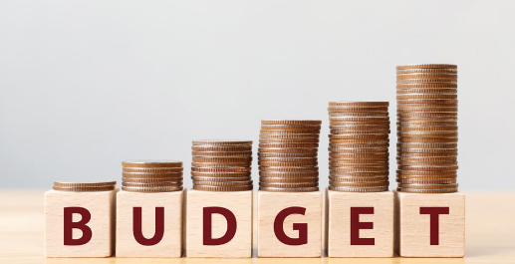
2024 – 2025 Budget
Budget Spreadsheet

Slide 11
Fundraising Incentives
Dues Incentive
Band Bucks
General Band Fund
$250
10% in Band Bucks
100% to the Band
Mulch
Sponsors
Spirit Nights
Concessions
Duck Race
Zumbathon
Football Squares
Field Props
Merchandise Sales
Raffles
Must complete 5 volunteer activities including:
1 Mulch drive
1 Concession shift
1 Moving props and equipment on the field or load and unload equipment from truck
2 others volunteer opportunities of your choice
10% of the money you bring in will be returned as “Band Bucks,” which can be used for:
Dues
Banquet tickets
Merchandise
No refunds will be given.
100% of the profit goes into the General Band fund.

Slide 12
By-Law Updates

Slide 13
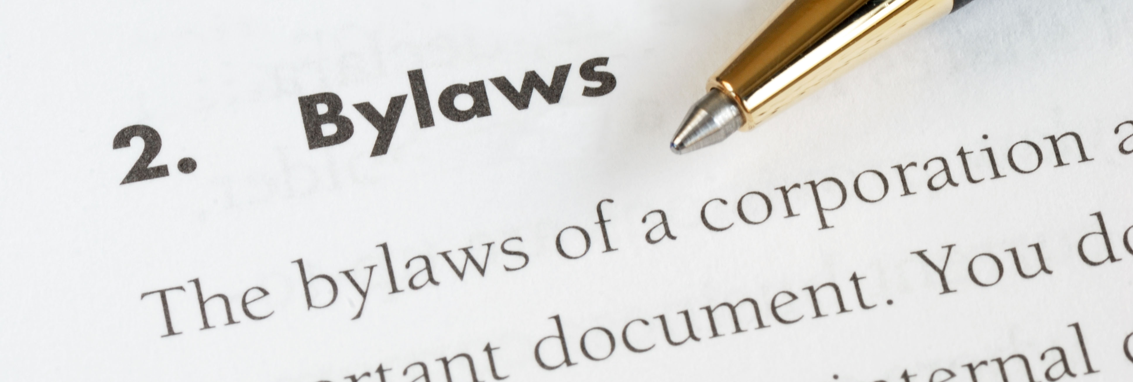
By Law Updates
Proposed Changes
Election terms
Vice President duties
Treasurer duties
Fundraising Manager duties
“Hospitality Manager” name change to “Student Food Manager”
Volunteer coordinator duties
Corporate Fundraising Liaison deletion
Organizational chart deletion

Slide 14
Board Elections

Slide 15
Board Elections
President – Jennifer Schmutz
Vice President – April Brenes
Treasurer – Alice Fasula
Communication Secretary – Aimee Mercer

Slide 16
Manager Positions
Position | 2024 – 2025 Manager | Underclassman Assistant Needed
Uniform Manager | Melissa and Trish Johnson | √
Student Food Managers | Julie Beatty and Renee Pease | Ilene Bomsar
Concessions Managers | Terri Nobile and Brandi Knowles
Equipment Manager | David Yake | Matt Cox
Volunteer Coordinator | Carol Diachun | √
Mulch Coordinator | Carol Diachun and Jennifer Schmutz
Website Manager | Brett Polakowski
Banquet Coordinator | Jen Cox
Middle School Coordinator | Ilene Bomsar
Student Accounts Manager | Venera Lajqi
Fundraising Manager
Color Guard Liaison

Slide 17
Questions?

